Slide 1
Mouse fatigue detection training a Neural Network for Arduino in TensorFlow

Slide 2
Introduction
We hope this presentation helps you understand, how to train, and implement a Neural network to predict forearm muscle pain levels, using Tiny Machine Learning, Arduino, and Tensorflow Lite
Machine Learning is a branch of artificial intelligence, focused on building applications that learn from data and improve their accuracy over time.
Deep Learning is a subset of machine learning, that utilizes Deep artificial neural networks for learning from large amounts of data
Tiny Machine Learning or Tiny ML is an area of development in the AI world. It refers to the use of small, lightweight neural networks that can be deployed on resource-constrained devices like microcontrollers.

Slide 3
Introduction
GSR stands for galvanic skin response and is a method of measuring the skin's electrical conductance.
GSR allows you to spot such strong emotions by simply attaching two electrodes to two fingers on one hand. It is interesting to create emotion-related projects like sleep quality monitor.
EMG detector is a bridge that connects the human body and electrical, the sensor gathers small muscle signals then process with 2th amplify and filter, the output signal can be recognized by Arduino.

Slide 4
What is this Project about?
A mouse fatigue detection dataset will be trained via TensorFlow.
Sensors will be connected to the Arduino's Wio terminal to measure forearm muscle soreness levels based on GSR (galvanic skin response) and EMG (Electromyography) measurements.
The Wio Terminal will display the collected muscle soreness data from its integrated TFT LCD screen. Successfully trained, the screen should display the muscle soreness data in three levels:
Relaxed
Tense
Exhausted

Slide 5
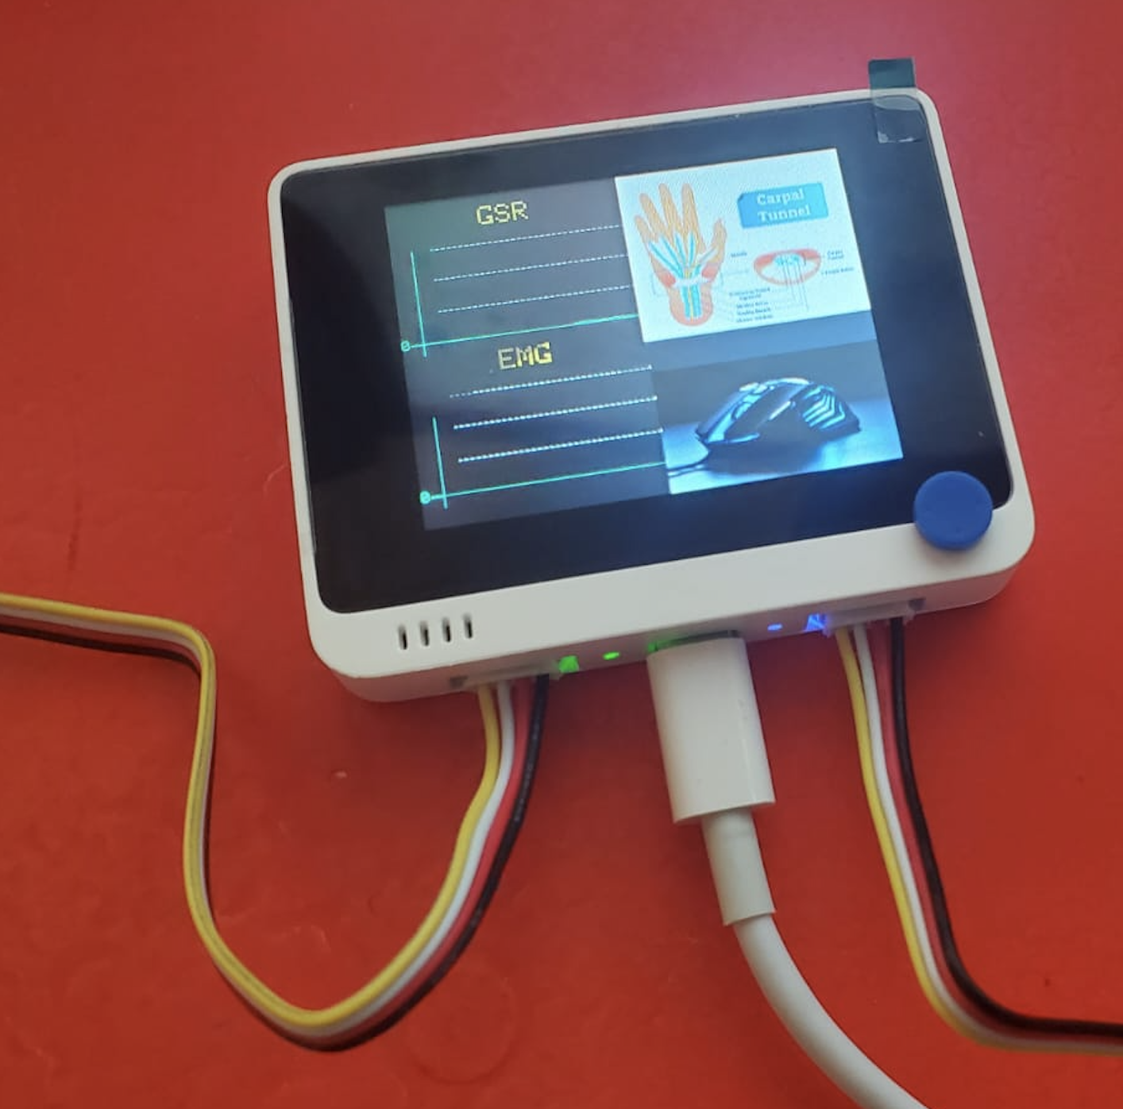
WIO Terminal: https://wiki.seeedstudio.com/Wio-Terminal-Getting-Started/

Slide 6
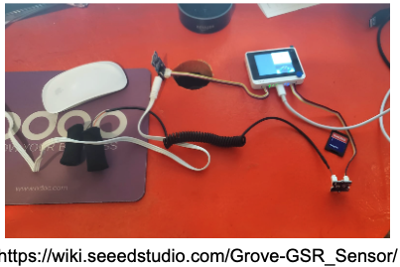
How to connect Galvanic skin response GSR sensor to WIO terminal

Slide 7
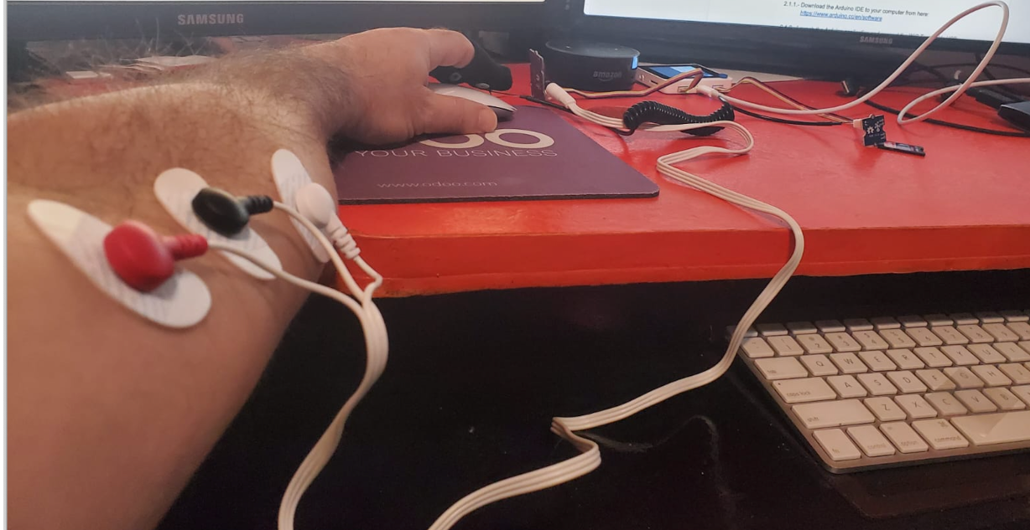
Finally, tack the three electrodes to your muscle, and keep a distance between each electrode.

Slide 8
Arduino IDE 1.8.19
Download the Arduino IDE to your computer from here: https://www.arduino.cc/en/software
Launch the Arduino application and connect the WIO Terminal to USB:
Double-click the Arduino IDE application you have previously downloaded.
Add WIO Terminal Board Library
Go to Arduino File | Preferences
Add Additional Boards Manager URL:
https://files.seeedstudio.com/arduino/package_seeeduino_boards_index.json

Slide 9
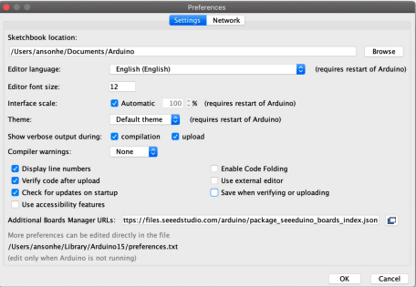
Preferences

Slide 10
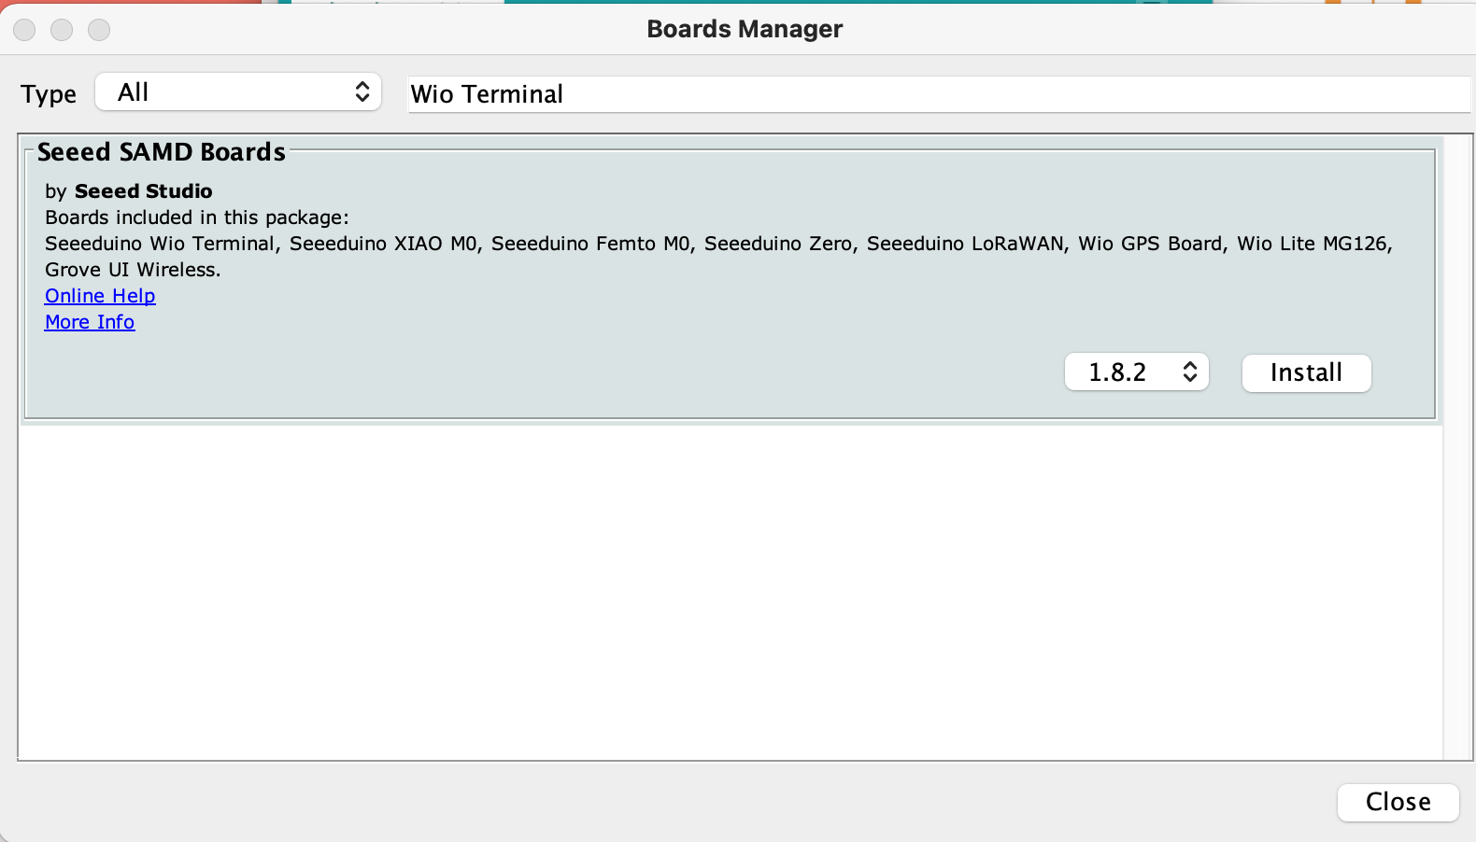
Set up the Seeed SAMD Arduino Core

Slide 11
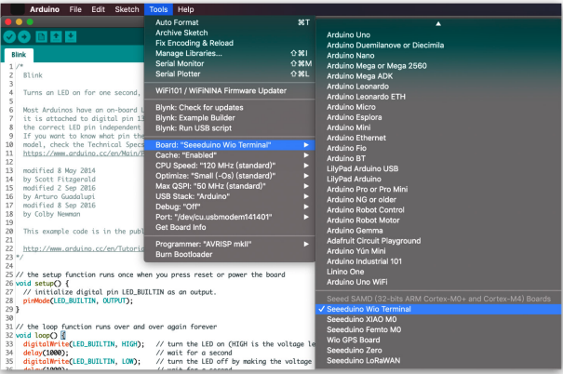
Open the Arduino IDE, click Tools | Board | Boards Manager, and search for Wio Terminal in the search box. Then, install Seeed SAMD Boards

Slide 12
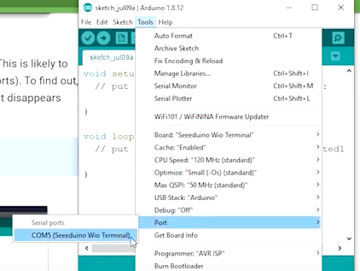
Selecting board and port
Select the Tools | Board menu entry that corresponds to your Arduino.
Select the Wio Terminal

Slide 13
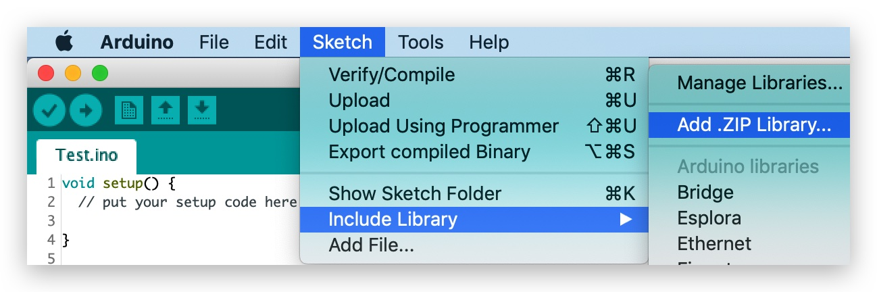
Installing the File System Library
Download the entire repo Seeed_Arduino_FS: https://github.com/Seeed-Studio/Seeed_Arduino_FS Open the Arduino IDE, click sketch | Include Library | Add .ZIP Library, and choose the Seeed_Arduino_FS file that you have just downloaded.

Slide 14
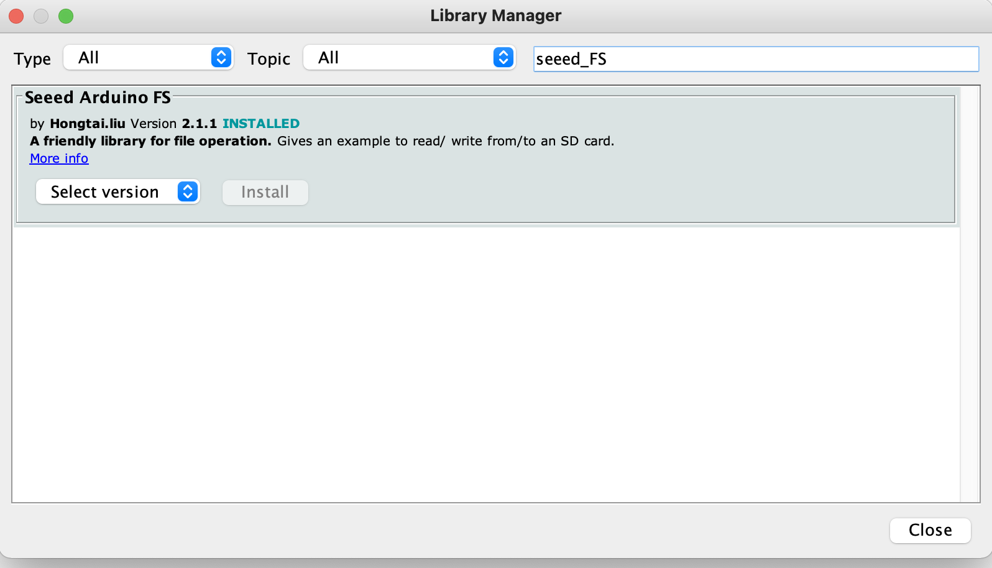
Check on sketch | Library Manager | Search for seeed_FS

